Slide 1
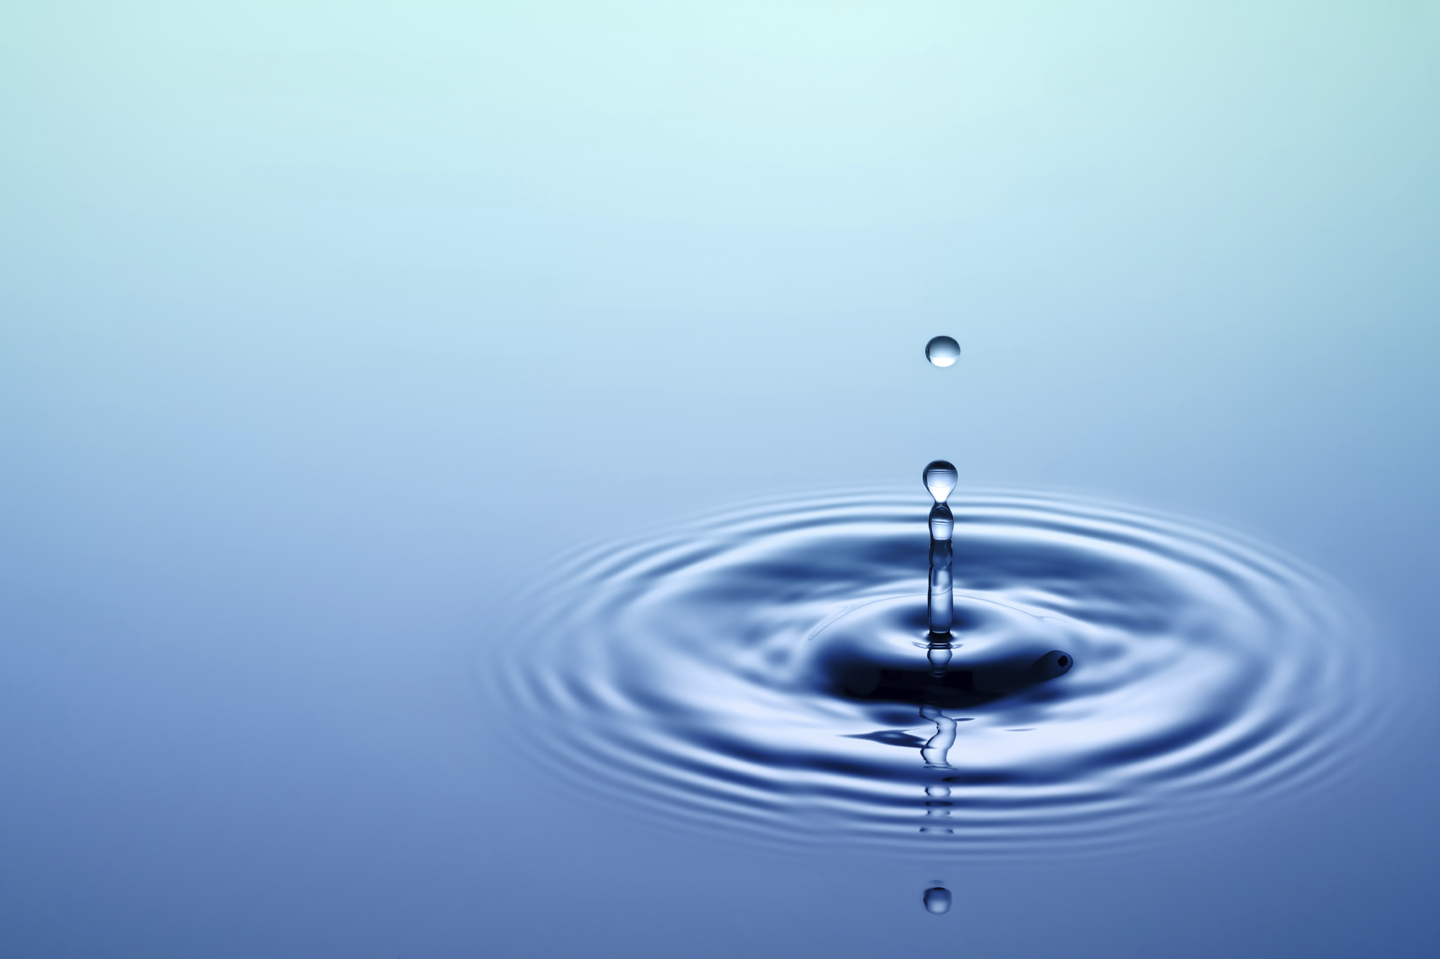
Extraction And Classification Of Contaminated Lakes.
Anushka Parashar(MT2017024)
Rohil Pal(IMT2015520)
Lakshmi Priya Ramisetty(IMT2015037)
Date 26/08/2018

Slide 2
Goal
Extraction of water bodies in Bangalore.
Classifying them on the basis of the level of contamination.

Slide 3
Motivation
Concerned about water pollution in Bangalore.
Interesting area of Research.

Slide 4
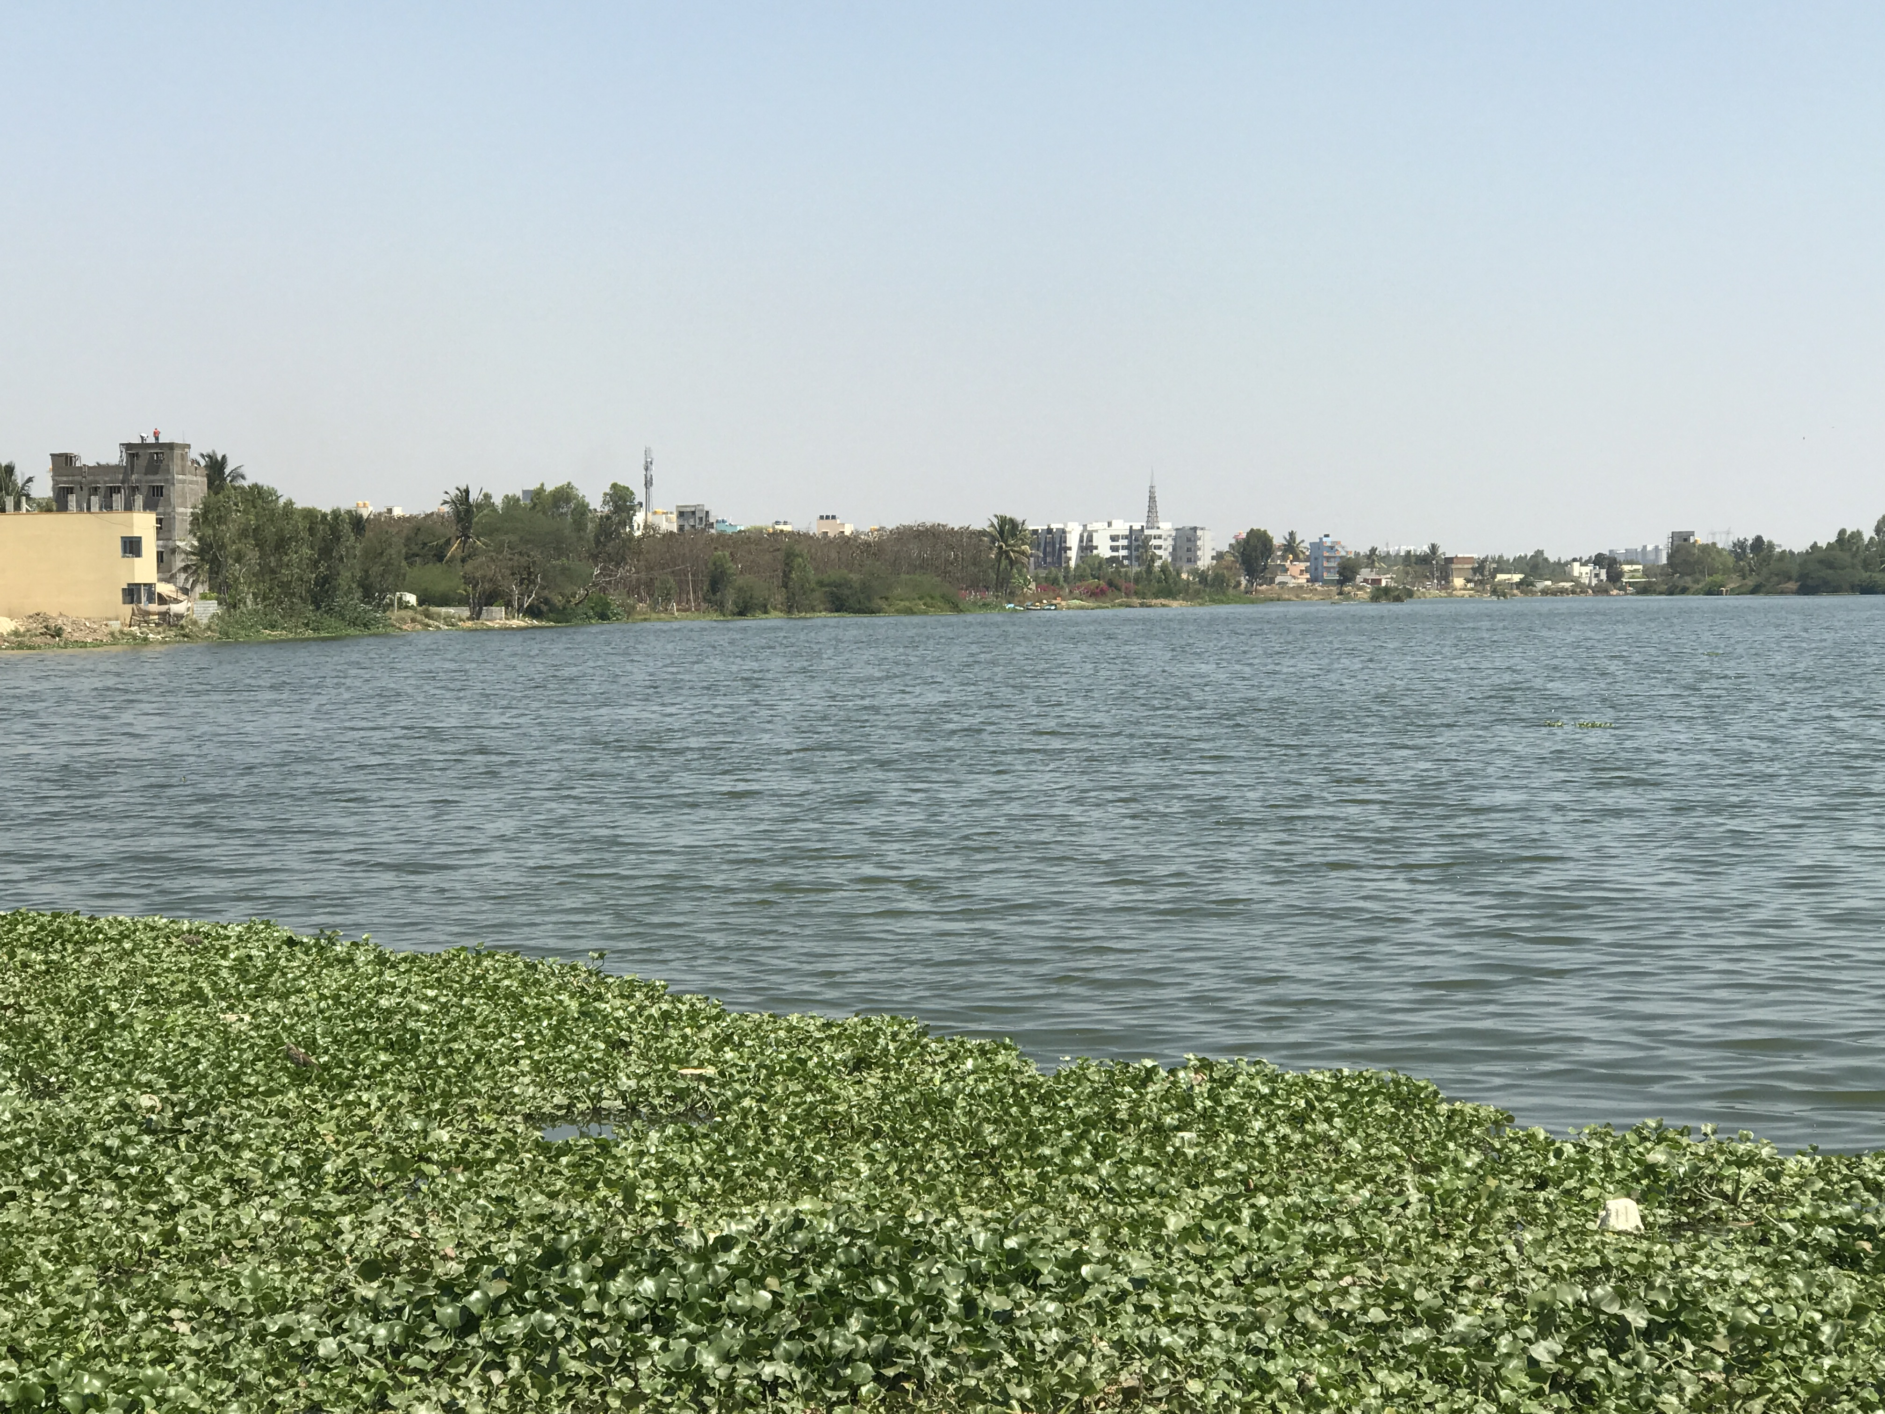
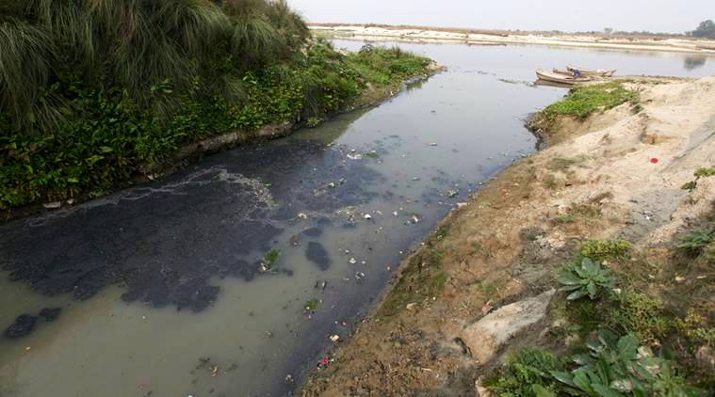

Slide 5
Data : Landsat 8
Landsat 8 is used as a collaboration between NASA and the US Geological survey(USGS).Landsat 8 instruments represent an evolutionary advance in technology. OLI includes on past Landsat sensors using a technical approach demonstrated by a sensor flown on NASA’s experimental EO-1 satellite. OLI is a push-broom sensor which collects data for visible, near infrared, short waves, infrared spectral bands as well as panchromatic bands.

Slide 6
It has a total of 11 bands including OLI and TIRS bands.
All the bands have a 30 m spatial resolution except TIRS bands which have a 100 m resolution and panchromatic band which has a resolution of 15 m.
TIRS collects data for two more narrow spectral bands in the thermal region formerly covered by one wide spectral band on Landsats 4-7.The 100 m TIRS data will be registered to the OLI data to create radiometrically and geometrically and terrain-corrected 12-bit data products.

Slide 7
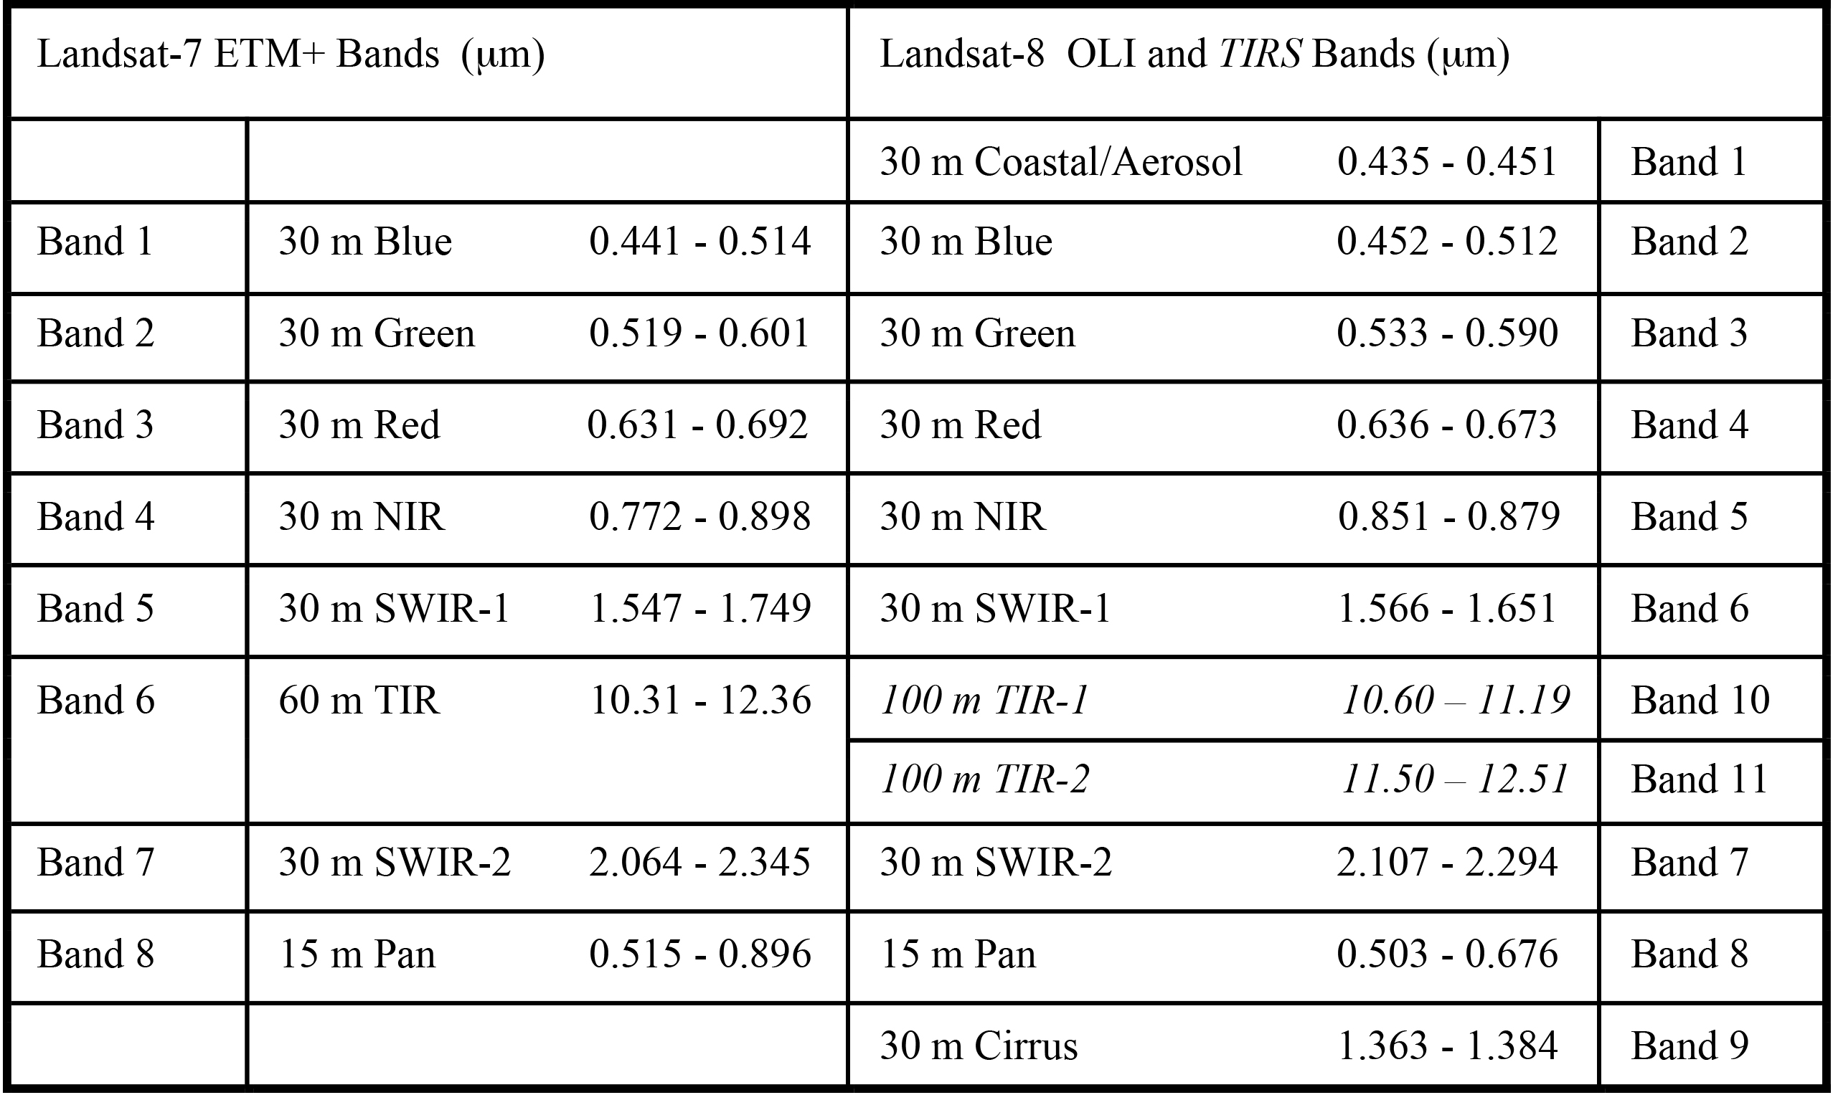

Slide 8
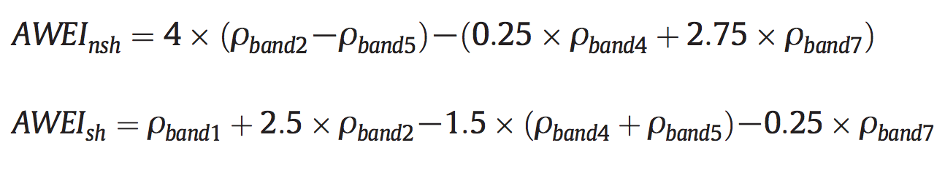
Extraction
We used AWEI(Automated Water Extraction Index) technique.

Slide 9
Five spectral bands of Landsat 7 were used in developing the AWEI index to increase the contrast between water and other dark surfaces. The primary aim of the formulation of AWEI was to maximise separability of water and non water pixels through band differencing, addition and applying different coefficients.
The coefficients used in the equations are empirical results determined based on reflectance patterns observed across the dataset of pure pixels of various land cover types.

Slide 10
Particular emphasis was given to the enhancement of the separability of water and dark surfaces surfaces such as shadow and built-up structures that are often difficult to distinguish due to similarities in reflectance patterns.
AWEInsh is an index formulated to effectively eliminate non water pixels, including dark built surfaces in areas with urban background and AWEIsh is primarily formulated for further improvement of accuracy by removing shadow pixels that AWEInsh may not effectively eliminate.

Slide 11
Why AWEI?
Other common indexes used for extracting water pixels in LANDSAT imagery are:
NDWI (Normalised Difference Water Index): It uses green (Band 2) and NIR(Band 4) of Landsat 5. The formula is:
The value is positive for water pixels and zero/negative for soil and vegetation pixel.
But it does not work well in water region with a build-up land background.

Slide 12
MNDWI(Modified NDWI): The only difference is that band 4 is replaced with band 5 or MIR(Middle Infrared) band of Landsat 5. The modified formula is:
Again, in this index positive values correspond to water pixels while zero/negative values correspond to soil/vegetation pixel.

Slide 13
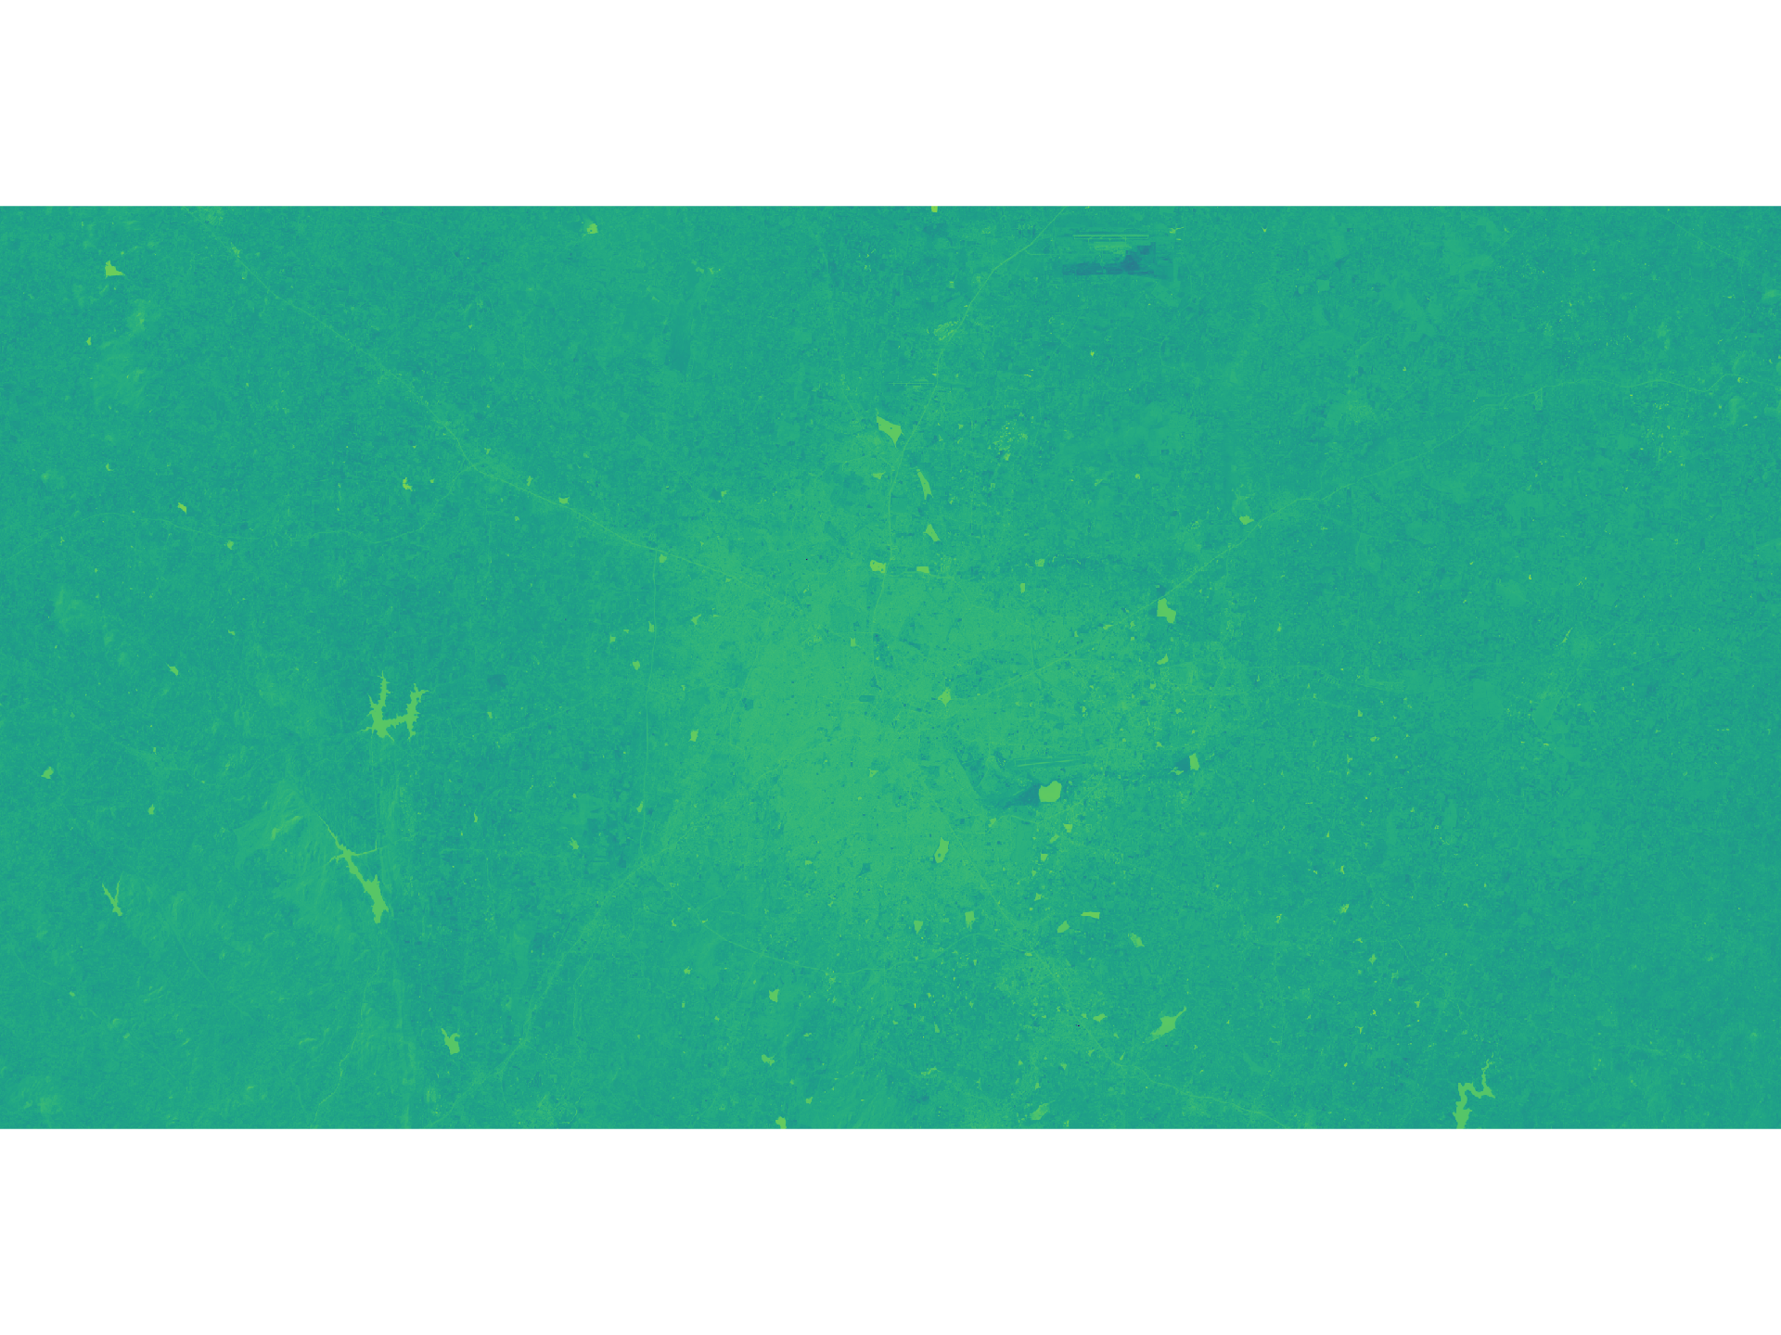
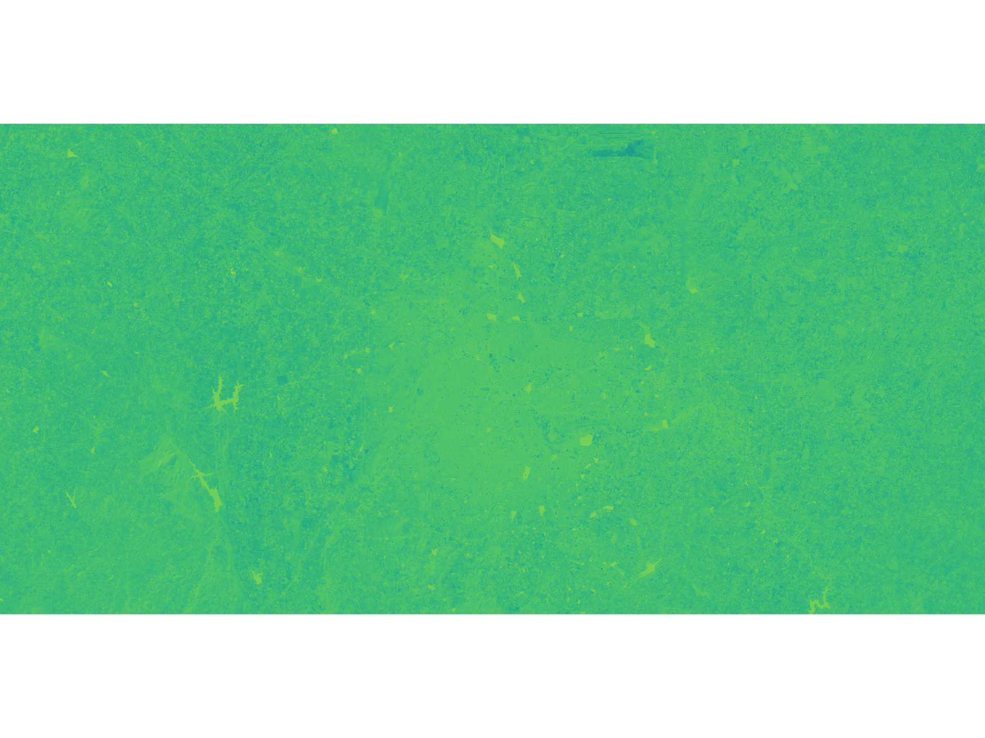
AWEIsh
AWEInsh

Slide 14
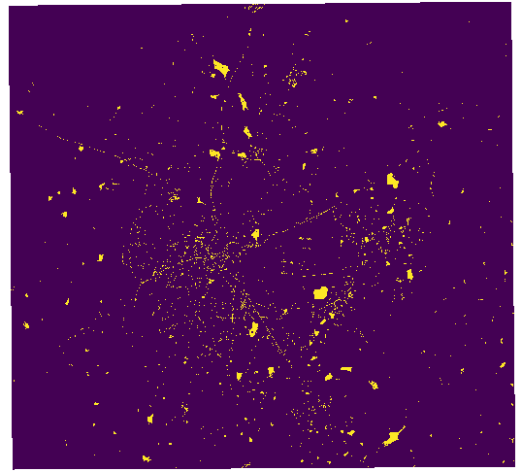
AWEI extraction
Yellow - Water pixels

Slide 15
Drawbacks of AWEI
Can’t differentiate between roads and water bodies.

Slide 16
Classification
We mainly used band 5 to classify the data because the overlap between contaminated and non contaminated is less compared to other bands.

Slide 17
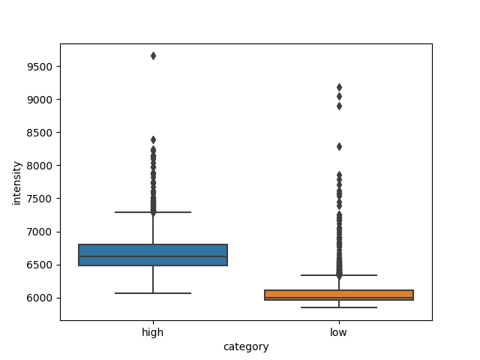
Intensity values in band 5 of highly contaminated and less contaminated lakes.

Slide 18

Pixel classification :-
Classes | Min. pixel value | Max. pixel value
Pure | 5400 | 6200
Contaminated | 6200 | 8000
Roads and water soil | 8000 | >8000

Slide 19

Pure Water pixels

Slide 20
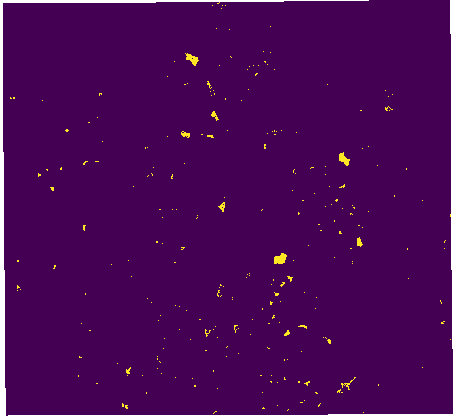
Contaminated Water pixels

Slide 21
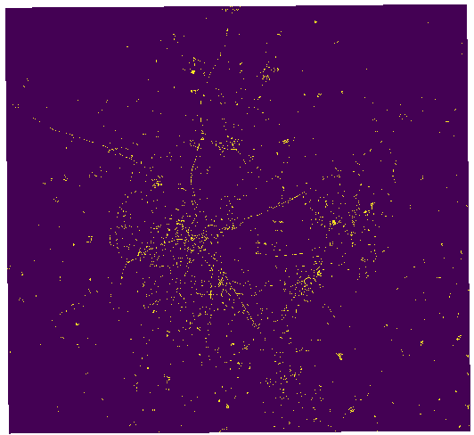
Road and Water-soil Pixels

Slide 22
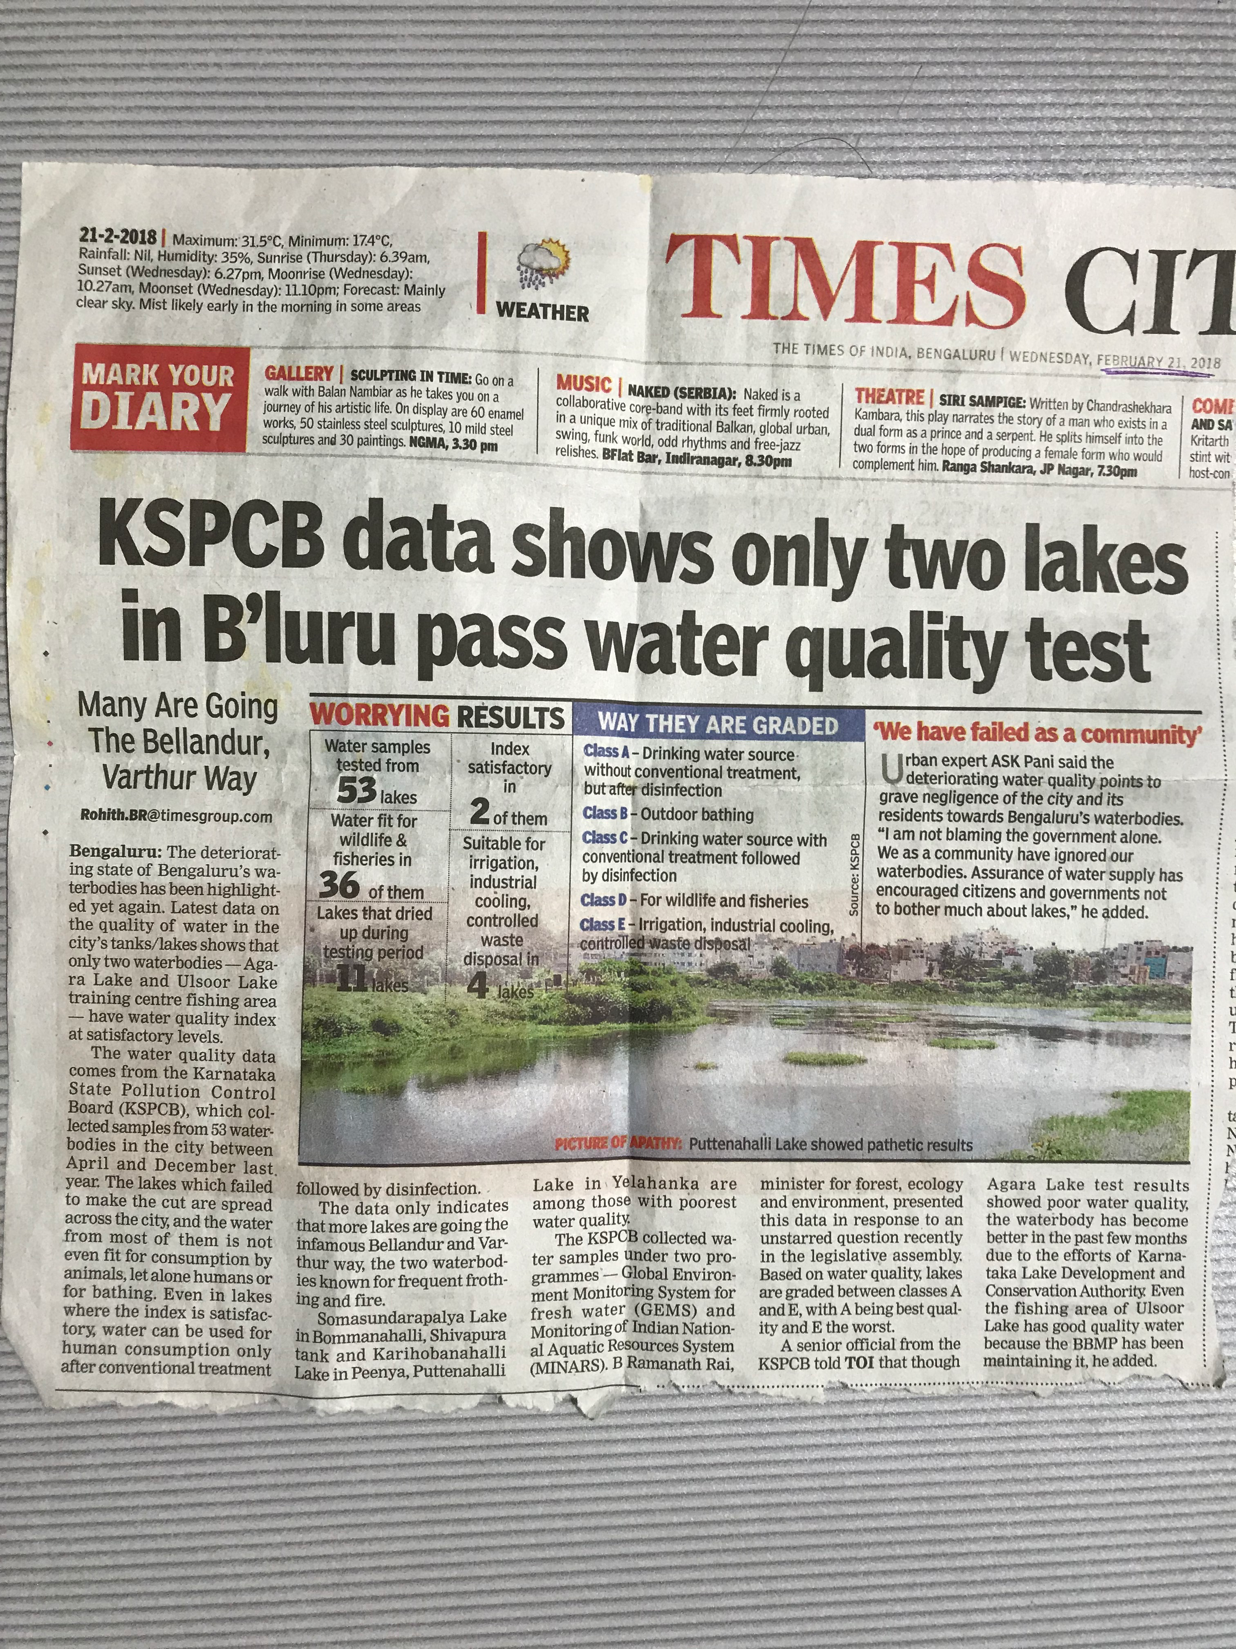
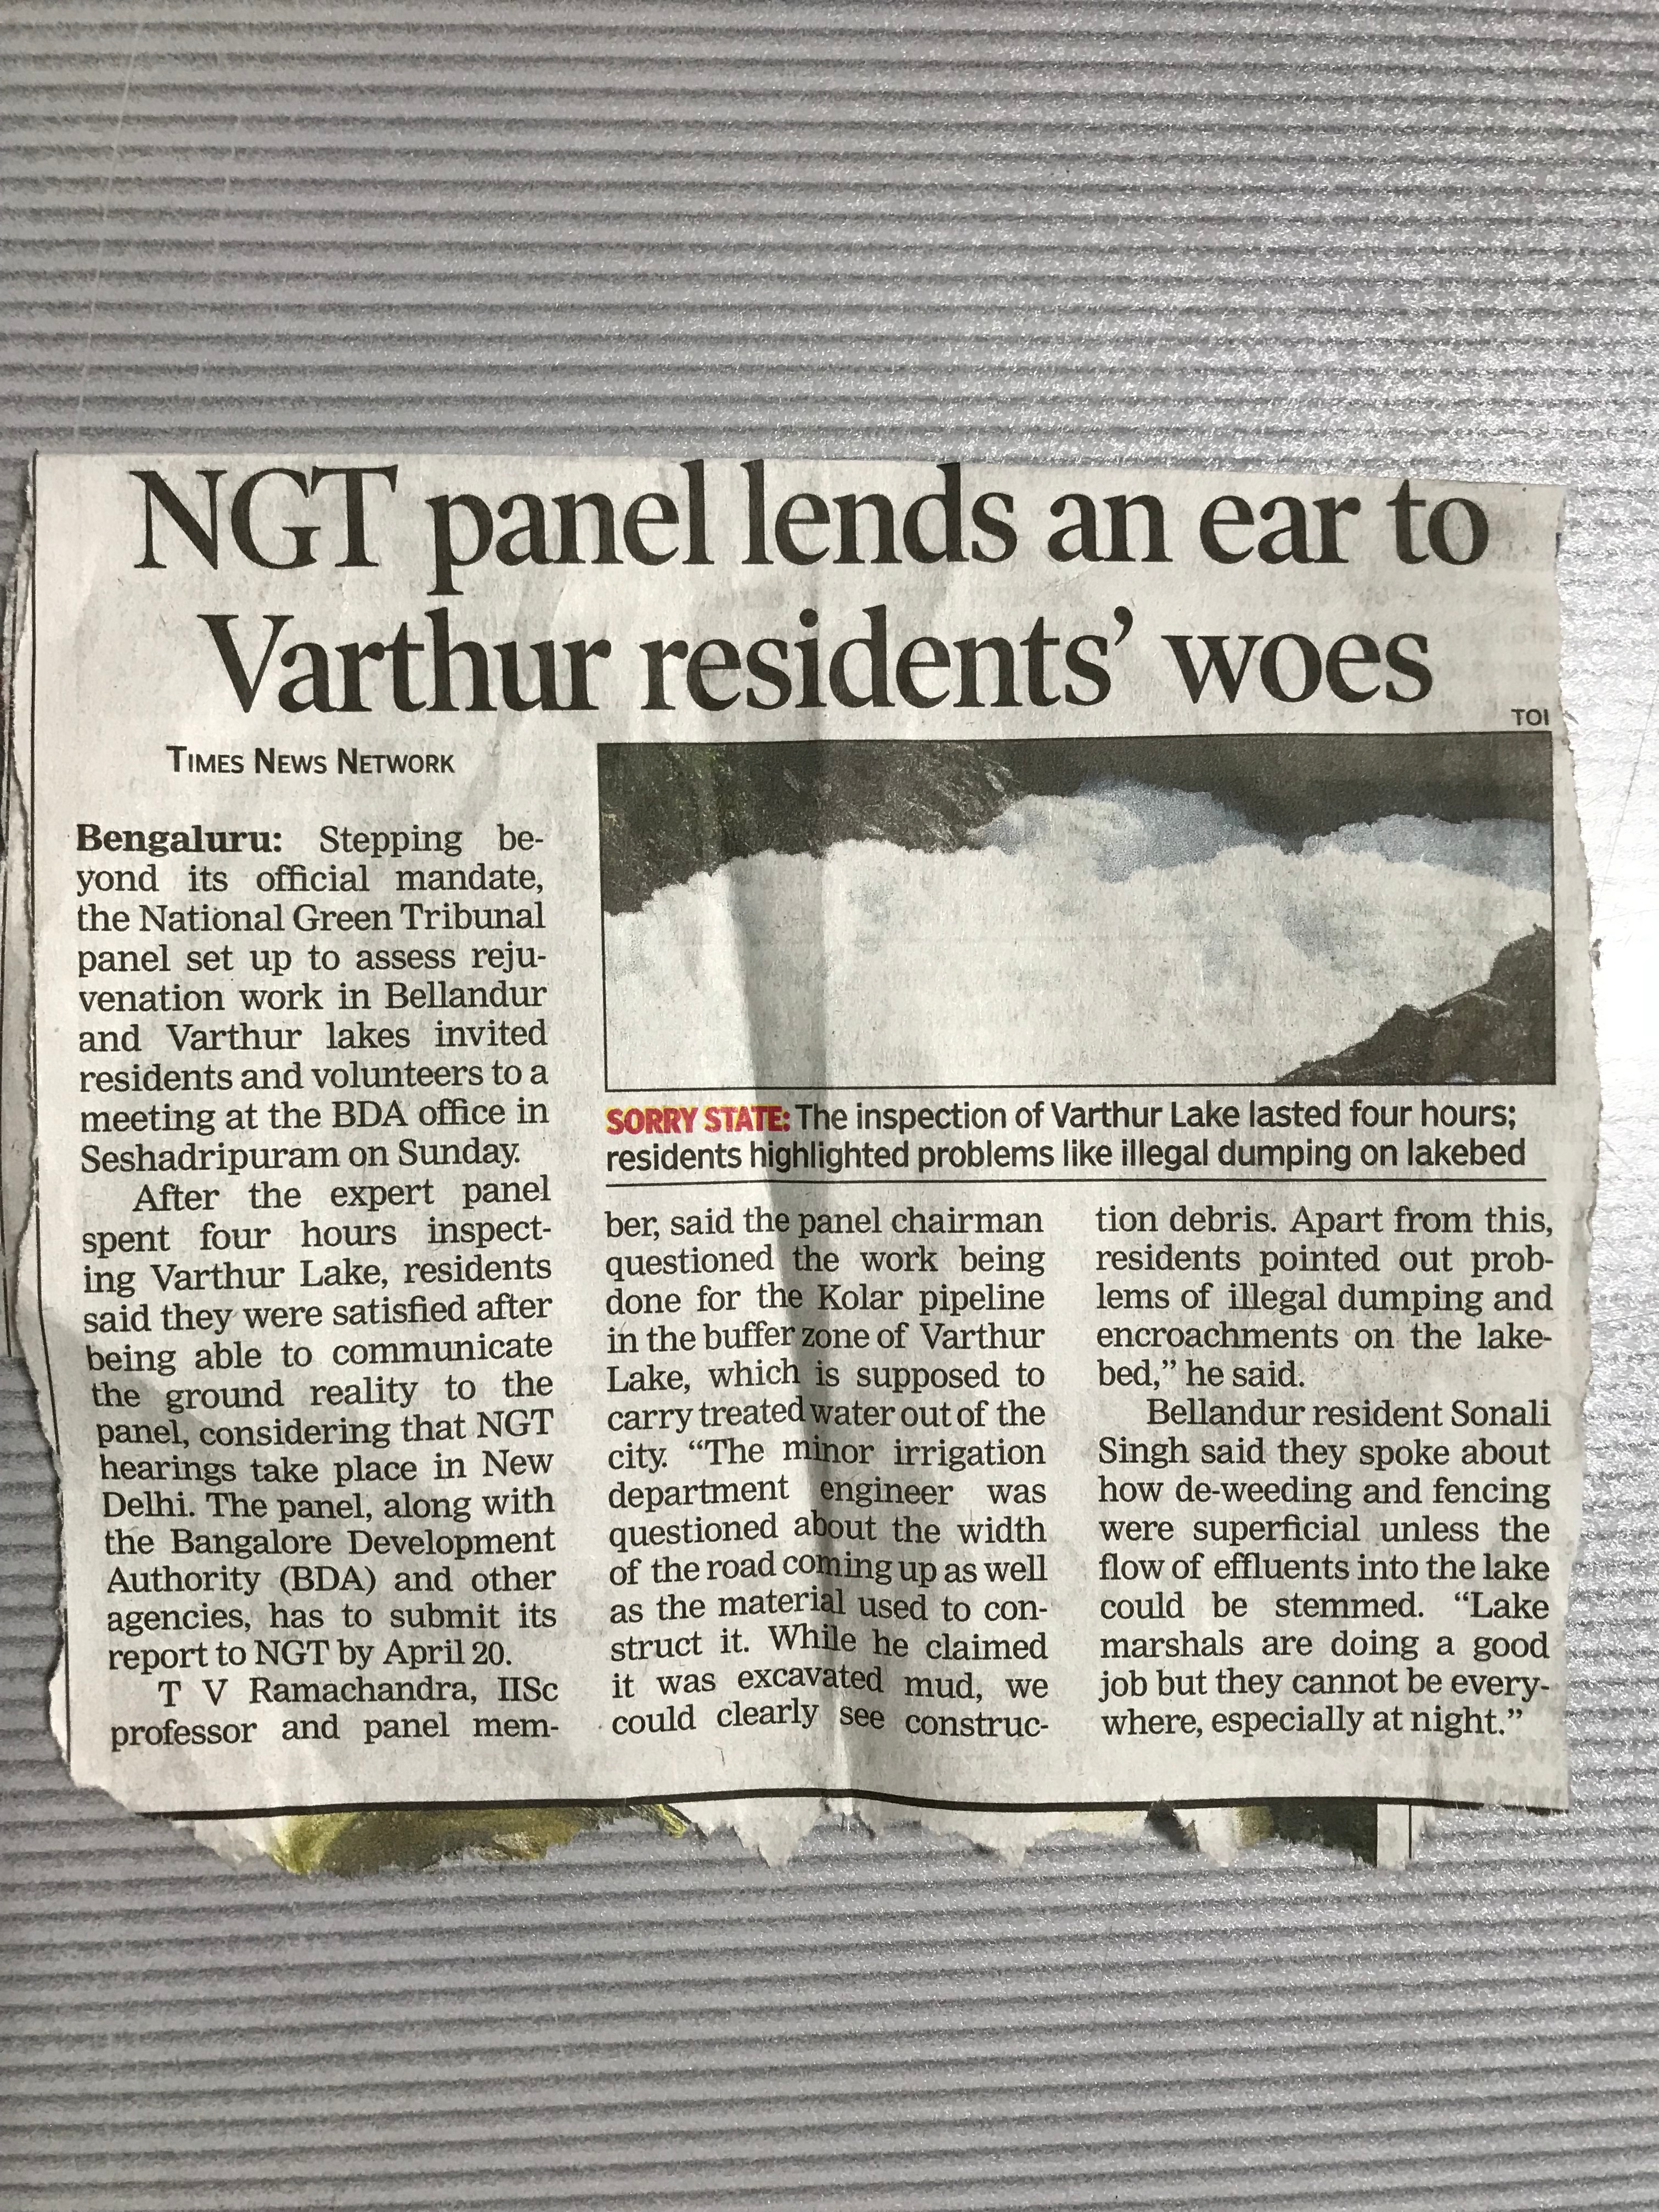
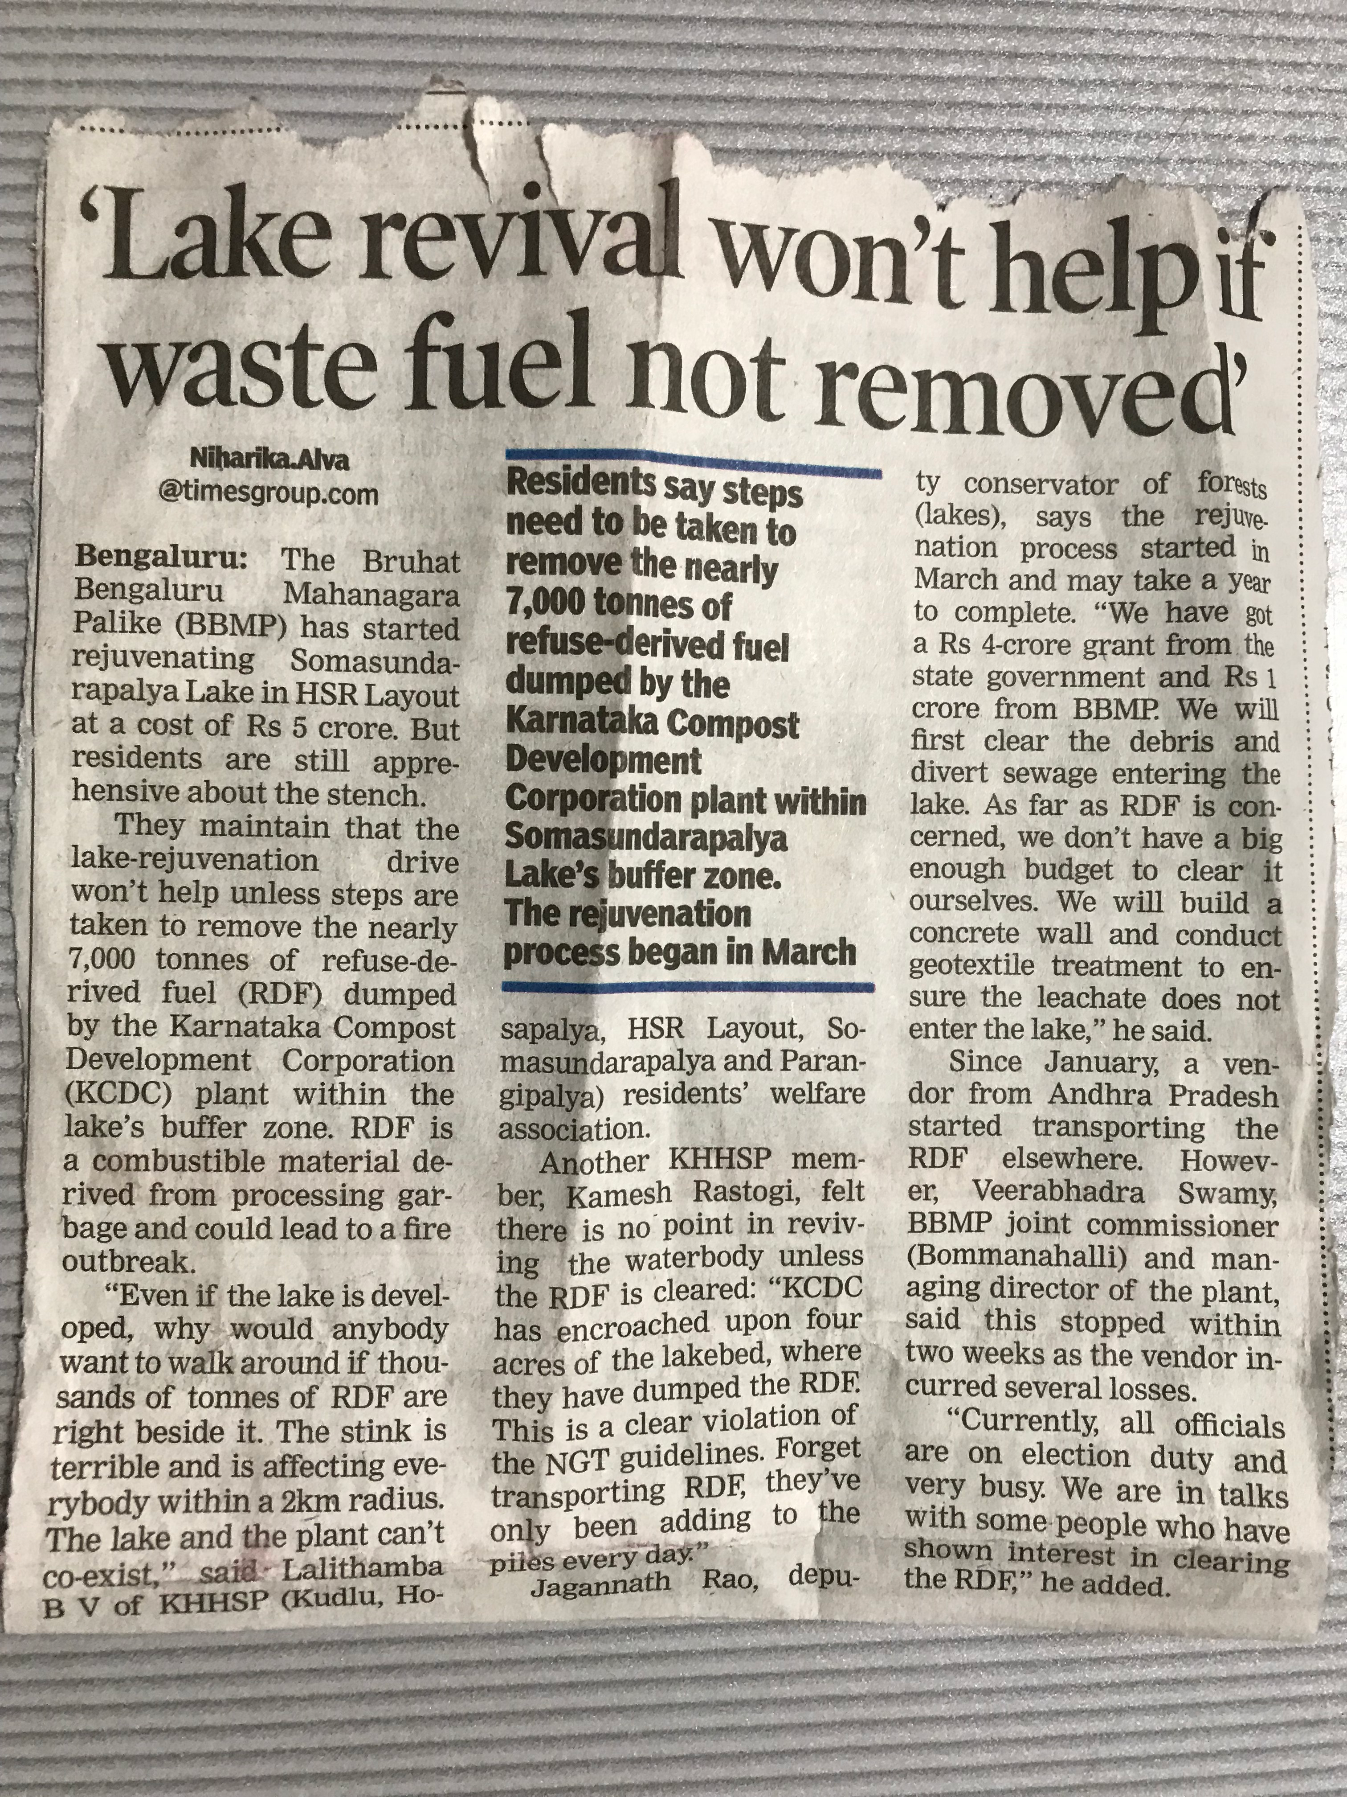

Slide 23
Comparison
We referred to two reports. One from KSPCB(2017) and the other from IISc(2016).
KSPCB says that Agara lake and Ulsoor lake have water quality index at satisfactory levels.According to our output, these two lakes have pure water pixels.
IISc says that Mylasandra lake 1 and lake 2 have better water quality. According to our output, these two lakes are under contaminated category.

Slide 24

Conclusion
Classes | No.of pixels | Area (sq.km) | Percentage
Bangalore | 1973866 | 1776.479 | 100%
AWEIsh (non-water) | 1938641 | 1744.769 | 98.215%
AWEIsh (water) | 35225 | 31.7025 | 1.784%
pure | 1675 | 1.5075 | 0.084%
contaminated | 12889 | 11.6001 | 0.6529%
roads/ water-soil | 20661 | 18.5949 | 1.0467%

Slide 25
Citations
Automated Water Extraction Index: A New technique for surface mapping using Landsat Imagery by Gudina Legese Feyisa Et al. (https://www.researchgate.net/publication/259093823)
Modification of Normalised difference water index(NDWI) to enhance open water features in remotely sensed imagery by Hanqiu Xu.(www.aari.ru/docs/pub/060804/xuh06.pdf)
Wetlands : Treasure of Bangalore (Abused, Polluted, Encroached and Vanishing) by Ramachandra T.V. Et al.(http://wgbis.ces.iisc.ernet.in/energy/water/paper/ETR101/ETR101_wetlands_treasure-P.pdf)

Slide 26
Thank you!

